Slide 1

UNIT-II FIBER OPTICS
Dr.A.Sivakami,
Associate Professor,
Department of Physics,
Malla Reddy University, Hyderabad.

Slide 2
Unit-II: Fiber optics
FIBER OPTICS: Introduction to optical fiber, Construction and working principle of an Optical Fiber, Acceptance angle and numerical aperture, Types of Optical fibers - Mode and Propagation through step and graded index fibers, Attenuation in optical fiber, Applications of optical fibers: Optical fiber communication system, MEDICAL AND SENSORS: PRESSURE AND LIQUID LEVEL SENSOR

Slide 3
Fiber Optics
The development of lasers and optical fiber has brought about a revolution in the field of communication systems. Experiments on the propagation of information – carrying light waves through an open atmosphere were conducted. The atmospheric conditions like rain, fog etc affected the efficiency of communication through light waves.
To have efficient communication systems, the information carried by light waves should need a guiding medium through which it can be transmitted safely.

Slide 4
Fiber Optics
This guiding mechanism is optical fiber. The communication through optical fiber is known as light wave communication or optical communication
A light beam acting as a carrier wave is capable of carrying more information than that of radio waves and microwaves due to its larger bandwidth.
Currently in most part of the world, fiber optics is used to transmit voice, video and digital data signals using light waves from one place to other place.

Slide 5
Father of fiber optics
The first ‘fiber optics’ was invented by Narinder Singh Kapany in 1956.
Narinder Singh Kapany is an Indian- born Sikh physicist. He is widely recognized as the “Father of Fiber Optics”. He was named and considered among one of the seven ‘Unsung Heroes’ in the ‘Businessmen of the Century’ issue by Fortune. Kapany is a prominent entrepreneur, research scholar, philanthropist, and art collector.

Slide 6

Father of fiber optics
Kapany’s groundbreaking work that the world is enjoying high-speed communication systems and radical medical procedures such as endoscopy,
spectroscopy, laser surgeries to name a few.

Slide 7
Definition
Fiber Optics is a technology in which signals are converted from electrical into optical signals, transmitted through a thin glass fiber and reconverted into electrical signals.
ADVANTAGES OF FIBER OPTIC COMMUNICATION
Higher information carrying capacity
Light in weight and small in size.
No short circuits as in case of metals
Low attenuation and transmission loss
High degree of signal security
Long life span

Slide 8
OPTICAL FIBER
* It is a CYLINDRICAL WAVE GUIDE
* Made up of transparent dielectric such as glass or clear plastic
* Thin strand of a metal is called a wire.
* Thin strand of dielectric material is called a fiber.

Slide 9
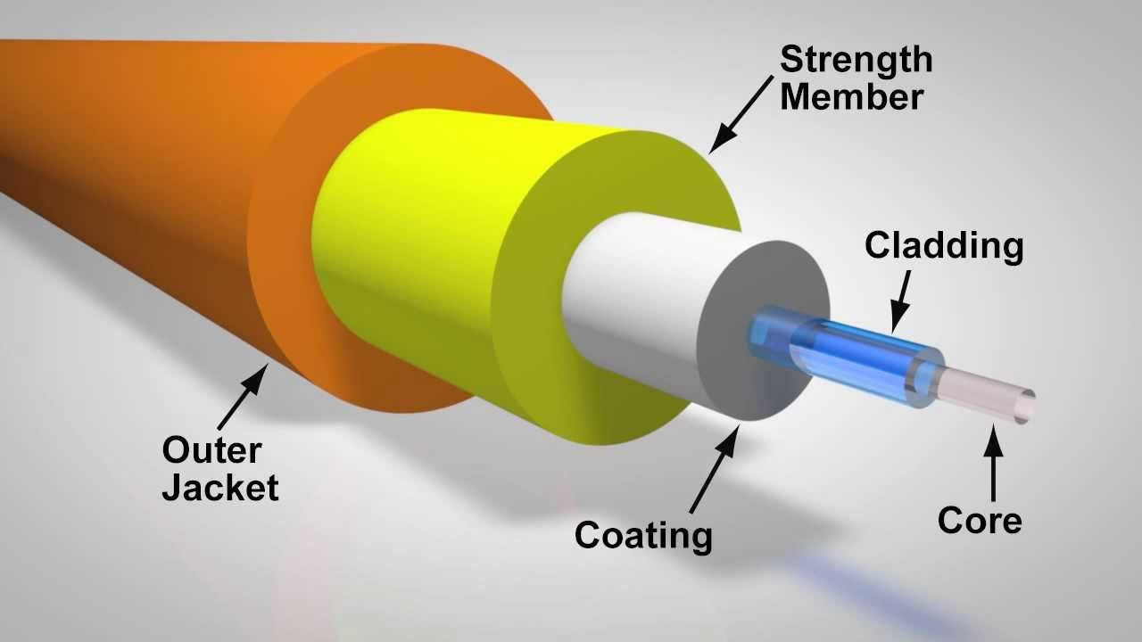
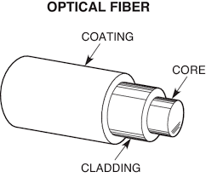
Construction of optical fiber

Slide 10
STRUCTURE OF OPTICAL FIBER
CORE: It consists of an inner cylinder made of glass or plastic called core. The core has high refractive index n1. It is the inner light-carrying layer. The core diameter range: 8.5 μm to 63.5 μm
CLADDING: This core is surrounded by cylindrical shell of glass or plastic called cladding. The cladding has low refractive index n2. It is the middle layer. Light is always launched into the core and striking the core-cladding interface. Diameter range: 125 μm
SILICON COATING: It is placed between buffer jacket and cladding to improve the quality of transmission of light.

Slide 11
STRUCTURE OF OPTICAL FIBER
BUFFER JACKET: it is made up of plastic and protects the fiber from moisture and abrasion
STRENGTH MEMBERS: In order to provide the necessary toughness and tensile strength it is surrounded the buffer jacket.
OUTER JACKET: It is the outermost layer. It is covered the fiber cable by black polyurethane
Because of this arrangement it is not damaged during hard pulling, bending, stretching or rolling. Diameter range including from coating to outer jacket: 250 μm to 900 μm .

Slide 12
Principle of light propagation through optical fiber
The principle of optical fiber is TOTAL INTERNAL REFLECTION [TIR] n1-refractive index of core; n2=refractive index of cladding; n0-refractive index of air
The light launched inside the core at one end of the fiber propagates to the other end due to total internal reflection at the core and cladding interface.

Slide 13
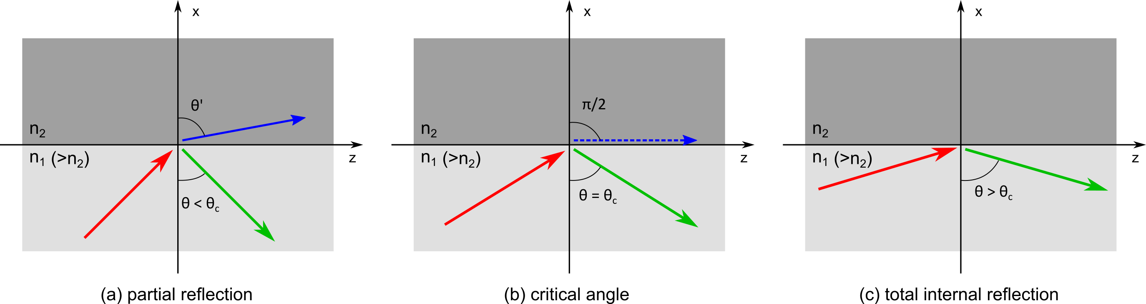
Principle of light propagation through optical fiber

Slide 14
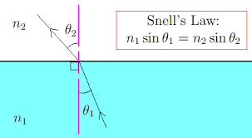
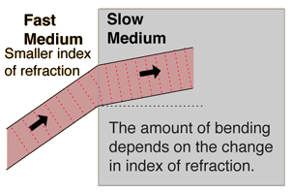

Snell’s law
Where, c-velocity of light in vacuum m/s
v-velocity of light in the medium

Slide 15
Let n₁ and n₂ be the refractive indices of core and cladding
respectively such that n₁>n₂.
Let a light ray travelling from the medium of refractive index n₁ to the refractive index n₂ be incident with an angle of incidence θ and the angle of refraction r. By Snell’s law,
n₁ sin θ = n₂ sin r ----------------------(1)
The refracted ray bends towards the normal as the ray travels from rarer medium to denser medium. On the other hand, the refracted ray bends away from the normal as it travel from denser medium to rarer medium. In Optical fiber, the light ray travelled from core (denser) to cladding (rarer) medium, there is possibility of total internal reflection, if the angle of incidence is greater than the critical angle (θ_{c}).

Slide 16
Definition of Critical Angle: When a light ray moves from high refractive index (core) medium to low refractive index (cladding) medium and for a particular angle of incidence the refraction angle (r) is 90º then the angle of incidence is known as critical angle (θ_{c}).
When θ < θ_{c}, then the ray refracted into the second medium as shown in figure.
When θ = θ_{c}, then the ray travels along the interface of two media as shown in the above figure.
When θ > θ_{c}, then the ray totally reflects into the same medium (core) as shown in the above figure.

Slide 17
The critical angle can calculated from Snell’s law, suppose if θ = θ_{c} then r = 90º, hence
n₁ sin θ_{c} = n₂ sin 90º
sin𝜃_{c}= n2/ n₁
𝜃c= sin^{–1}(n₂/n₁)
This is known as critical angle of mediums of refractive indices n₁ and n₂ (n₁> n₂).

Slide 18
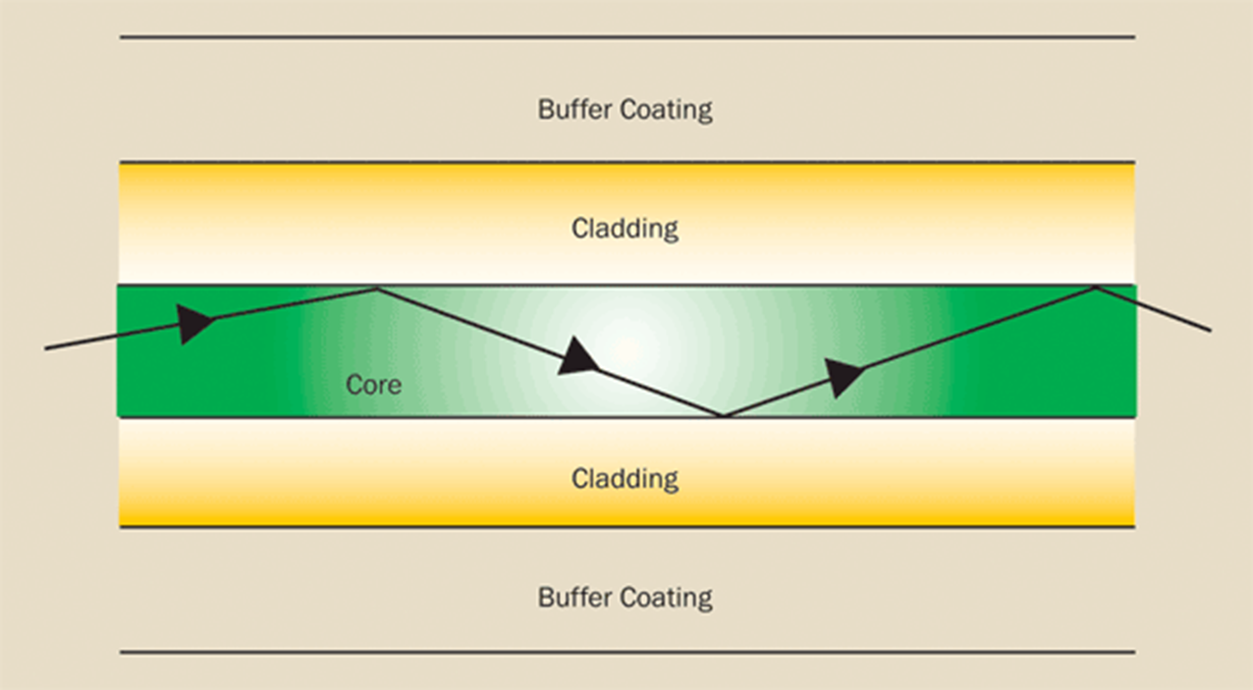
The light signal once entered the fiber and takes total internal reflection within the core as shown in figure, it will continue to propagate till the other end of the fiber.

Slide 19
Conditions of TIR
Total internal reflection at the fiber wall can occur only if two conditions are Satisfied.
1. The refractive index of the core material n1 must be higher than that of the cladding n2 surrounding it. [n1>n2]
2. At the core – cladding interface, the angle of incidence ( between the ray and normal to the interface) must be greater than the critical angle. [θi>θc]
sinθc=n2/n1

Slide 20
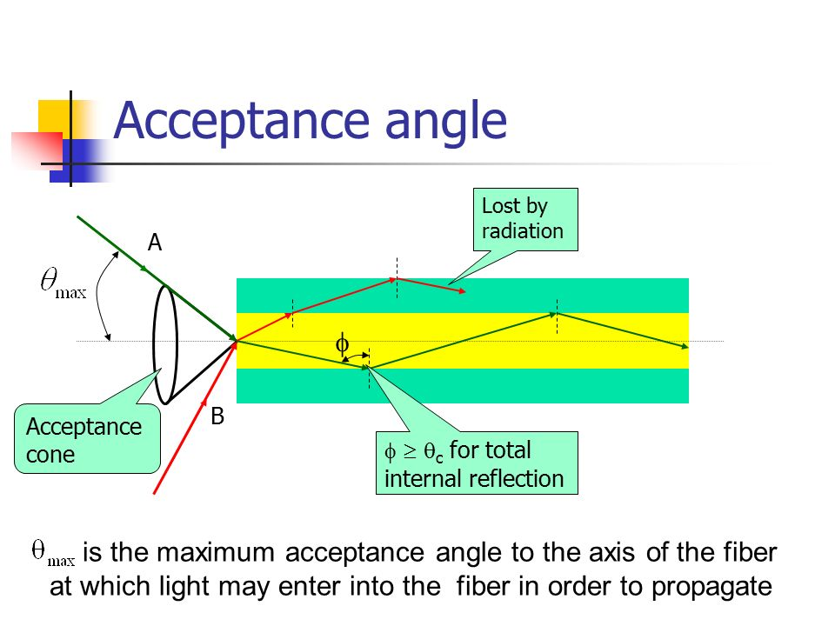

Slide 21
Acceptance angle
The maximum angle of incidence that a ray can make that will result in total internal reflection is called acceptance angle.
(or)
the maximum angle at or below which the light can suffer Total Internal Reflection is called acceptance angle.
Let us consider a cross-sectional view of an optical fiber along its length as shown in figure.
When we launch the light beam in to the fiber at its one end the entire light may not pass through the core and propagate. Only the rays which make the angle of incidence greater than critical angle undergo total internal reflection and propagate through the core and all other rays are lost.

Slide 22
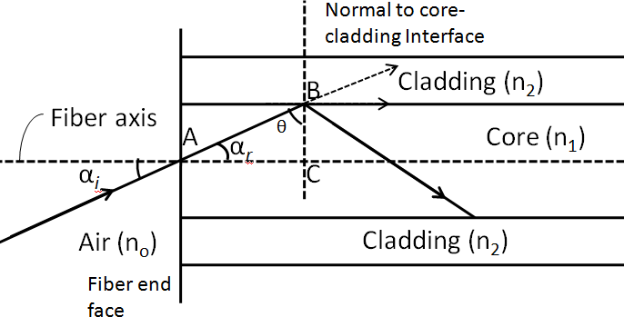
Let us consider a ray enters the core of refractive index n₁ from air medium of refractive index n_{o} with an angle of incidence α_{i} or ‘i’ at the interface of air and core and incident at the interface of core and cladding with an angle of incidence θ as shown in below figure.

Slide 23
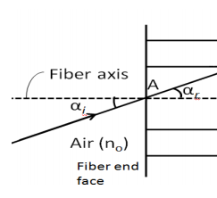



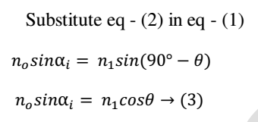
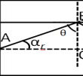
Acceptance Angle and Numerical Aperture
Step-1
Applying Snell’s law at air-core interface
n₁
Step-2
Let a normal ‘BC’ be drawn from the point ‘B’ to the fiber axis. Then from ∆ABC, we get
From the figure parallel lines concept
α_{r}
To get total internal reflection at point B (core-cladding interface) i.e. θ > θc

Slide 24



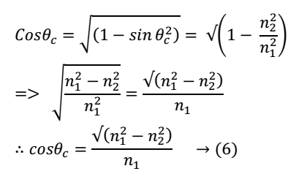
Acceptance Angle and Numerical Aperture
From equation (3), we get
when θ = θ_{c} , α_{i} = α_{i} (max)
Step-3
From critical angle formula

Slide 25






Acceptance Angle and Numerical Aperture
Quite often the incident ray is launched from air medium thus substitute n₀ = 1
Designating α_{i}(max) = i_{0,} hence i₀ =
The angle i₀ is called the acceptance angle of the fiber

Slide 26
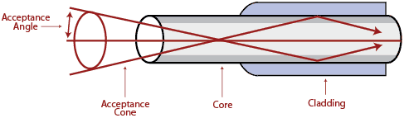
Acceptance cone
ACCEPTANCE CONE: The acceptance cone is derived by rotating the Acceptance Angle about the fiber axis. Light launched at the fiber end within this acceptance cone alone will be accepted and propagated to the other end of the fiber by total internal reflection. Larger acceptance angles make launching easier.
Definition: In three dimensions, the light rays contained within the cone having a full angle 2im are accepted and transmitted along the fiber. The cone is called acceptance cone.
.

Slide 27
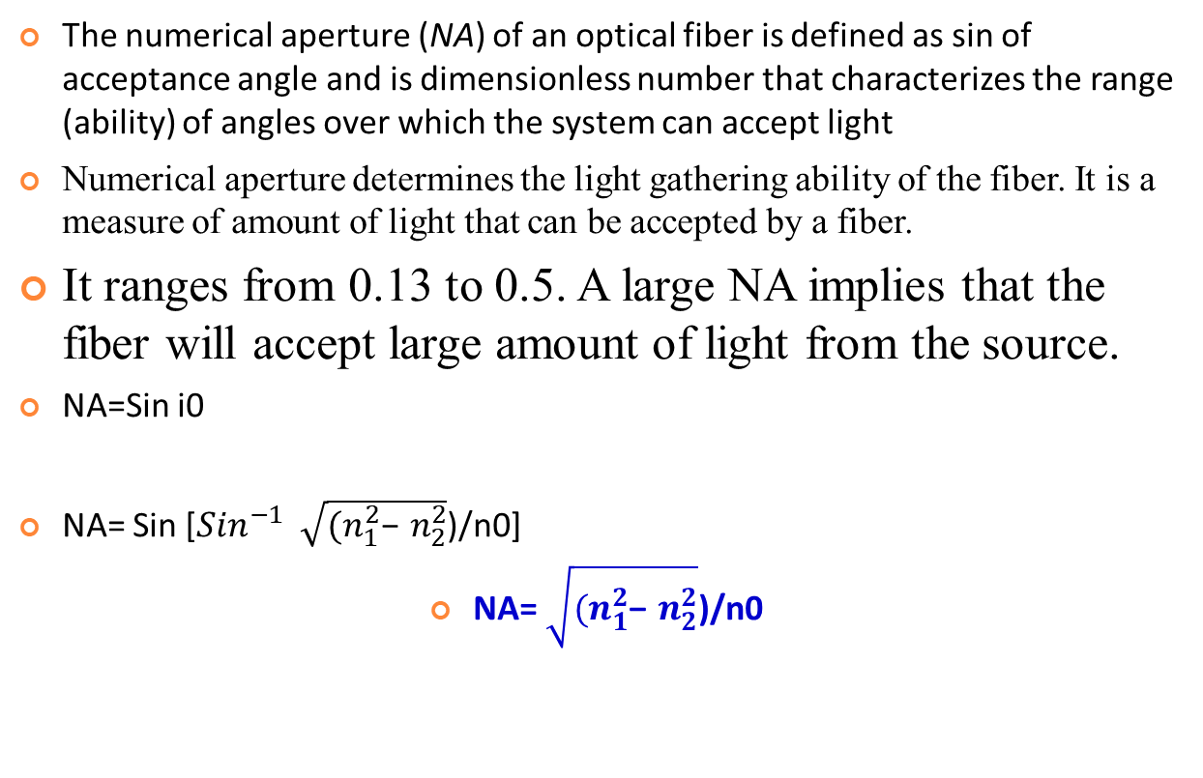
Numerical Aperture
Designating α_{i}(max) = i_{0,} hence i₀ =

Slide 28
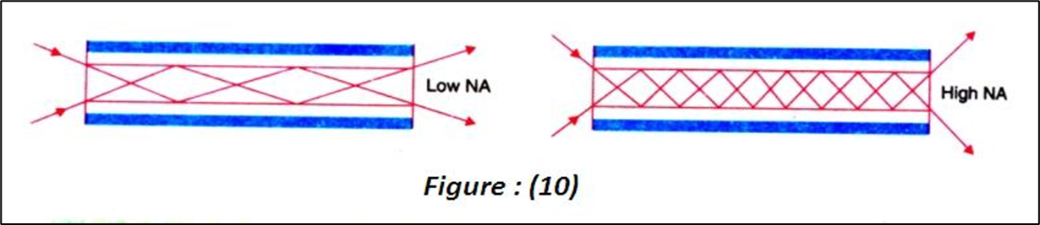
FRACTIONAL REFRACTIVE INDEX CHANGE
The fractional difference Δ between the refractive indices of the core and the cladding is known as the fractional refractive index change.
The value of Δ is always positive because n₁ must be greater than n₂ for the total internal reflection condition.
In order to guide light rays effectively through a fibre, Δ<<1 and Δ is of the order of 0.01

Slide 29
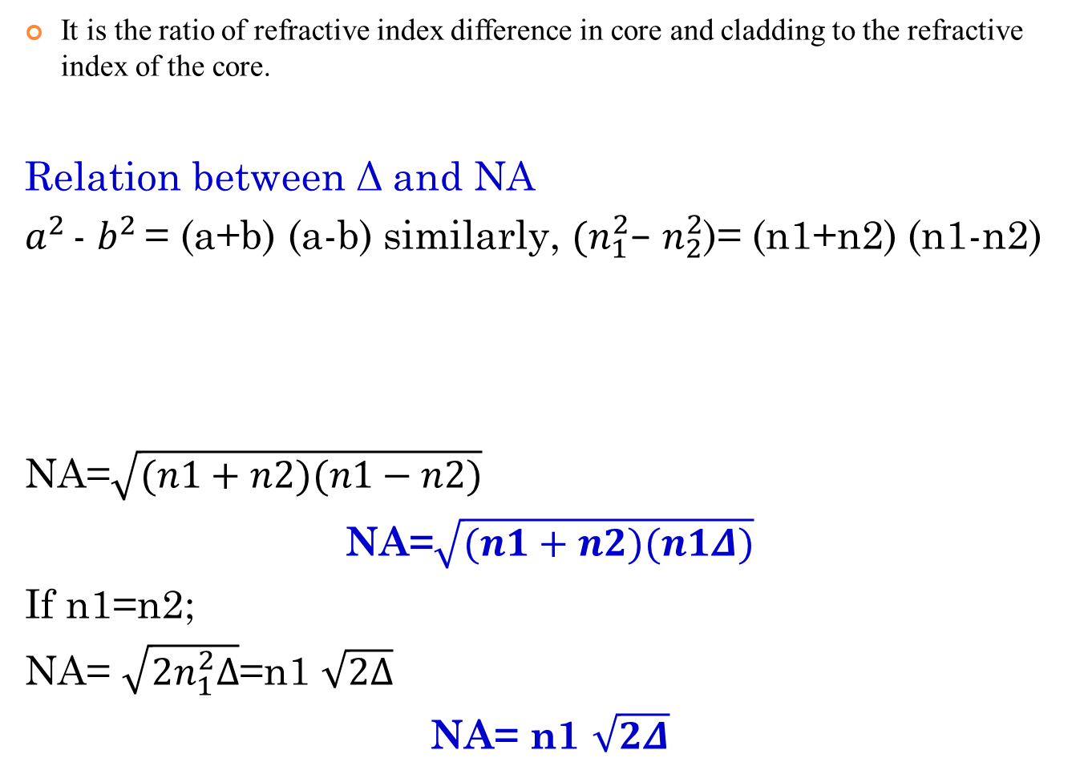
Fractional Index Change

Slide 30
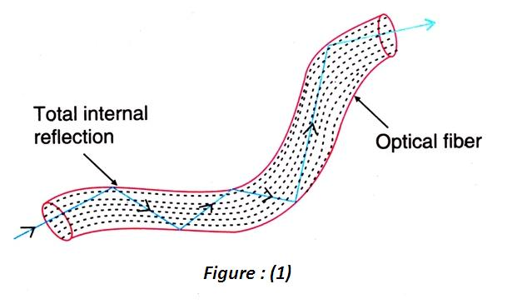
Optical Fiber

Slide 31
Types of optical fibers
Optical fibers are classified into three major categories
i. The type of material used
ii. The number of modes
iii. The refractive index profile

Slide 32
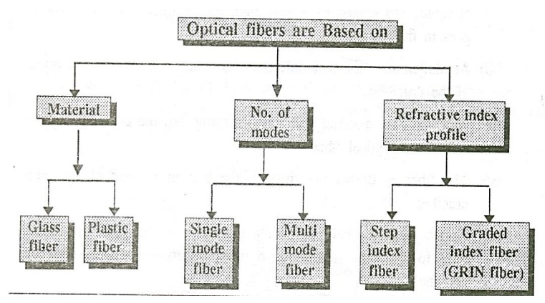
Types of optical fibers

Slide 33
Based on the type of the material used, they are classified into two types
1. Glass fiber:
Example:
Core: SiO2 Cladding: SiO2
Core: GeO2- SiO2 Cladding: SiO2
2. Plastic fiber:
Example:
Core: polymethyl methacrylate : Cladding: Co- Polymer
Core: Polystyrene : Cladding: Methyl methacrylate

Slide 34
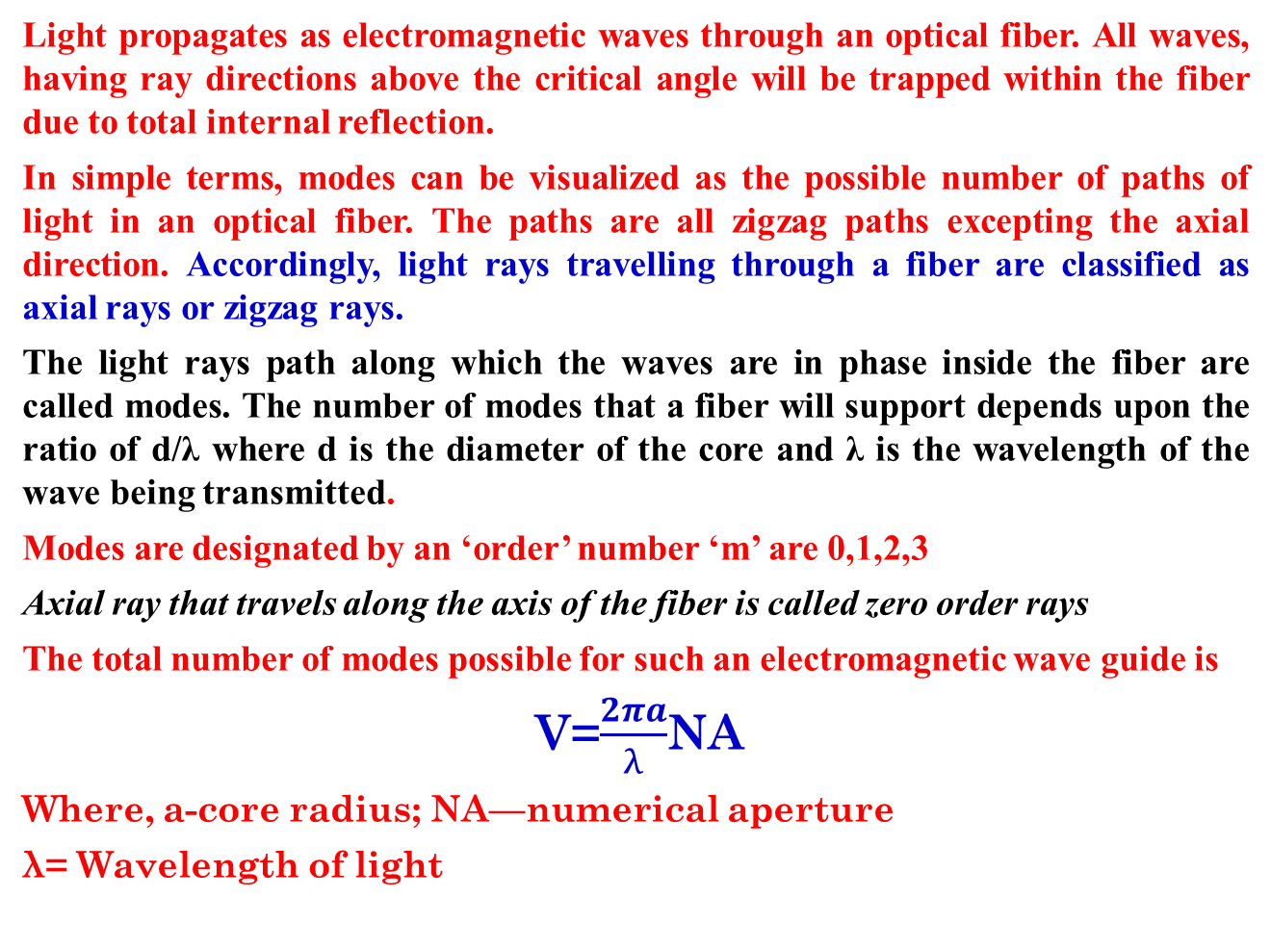
MODES of PROPAGATION

Slide 35
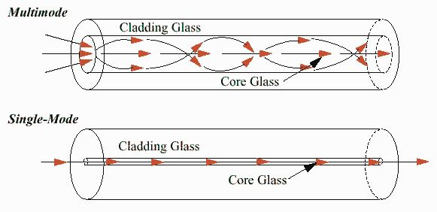
Single mode & Multimode optical fibers

Slide 36
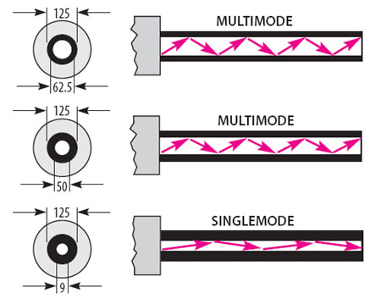

Slide 37
Single mode optical fiber [SMF]
As its name suggests, in single-mode fiber, only one mode can propagate through the fiber. In this, the diameter of the small core is 5um to 10 micrometer, and the diameter of cladding is 70um. Also, the difference between the refractive indexes of core and cladding is minimal. There is no dispersion of light in the single-mode fiber. there is no degradation of the signal when the light is traveling through the fiber.
Structure of SMF
Core diameter : 5-10μm
Cladding diameter : Generally around 125μm
Protective layer : 250 to 1000μm
Numerical aperture : 0.08 to 0.10
Band width : More than 50MHz km.

Slide 38
Single mode optical fiber [SMF]
Structure of SMF
Core diameter : 5-10μm
Cladding diameter : Generally around 125μm
Protective layer : 250 to 1000μm
Numerical aperture : 0.08 to 0.10
Band width : More than 50MHz km.

Slide 39
Characteristics & applications of SMF
The diameter of glass core in single mode fiber is very small ranging from 8 to 10 microns.
• In this mode, light can propagate only in a straight line, without bouncing.
• Fiber glass has lower density (index of refraction) that creates a critical angle close enough to 90° such that the beam propagates in a straight line.
• In this case, propagation of different beams is almost identical and delays are negligible. The beams arrive at destination together and can be recombined with little distortion to the signal.

Slide 40
Characteristics & applications of SMF
• Single mode fibers are more expensive and are widely used for long distance communication.
• These types of fibers can transmit data at 50 Gbps for 100 kilometers without amplification.
• It makes use of a laser light source. In this, light pulses are generated by the injection laser diodes (ILD).
•The light is passed through the laser diode in this mode of fiber.

Slide 41
MULTIMODE Optical fiber [MMF]
It can allow many modes to propagate through it and hence called as Multi mode fibers. The cladding diameter is also larger than the diameter of the single mode fibers.
Structure of MMF
Core diameter : 50-350μm
Cladding diameter : 125μm - 500μm Protective layer : 250 to 1100μm
Numerical aperture : 0.12 to 0.5
Band width : Less than 50MHz km.

Slide 42
CHARACTERISITCS & APPLICATIONS OF MMF
In multimode fiber, multiple beams travel in the core in different paths.
In multimode fiber, the diameter of core is about 50 microns.
In this, the diameter of the core is 40um and diameter of cladding is 70um.
Due to multi-mode dispersion, there is degradation of signal in this.
The relative refractive index difference in multi-mode fiber is more significant than the single-mode fiber.

Slide 43
CHARACTERISITCS & APPLICATIONS OF MMF
Multi-mode fiber is not suitable for the long-distance communication because of large dispersion and attenuation of the signal.
It can support less bandwidth as comparative to single-mode fiber.
In this, the data rate is up to 1 Gbps.
Multi-mode fibers are further categorized into Step index fibers and Graded index fibers.

Slide 44
Difference between SMF & MMF
S.No | SMF | MMF
1 | In single mode fiber only one mode can propagate through the fiber | In multimode it allows a large number of paths or modes for the light rays travelling through it.
2 | It has smaller core diameter and the difference between the refractive index of the core and cladding is very small. | It has larger core diameter and refractive index difference is larger than the single mode fiber
3 | Advantages: No dispersion(i.e. there is no degradation of signal during propagation) Since the information transmission capacity is inversely proportional to dispersion the fiber can carry information to longer distances. T=1/D | Disadvantages: Dispersion is more due to degradation of signal owing to multimode. Information can be carried to shorter distances only.
4 | Disadvantages: Launching of light and connecting of two fibers difficult. Installation (fabrication) is difficult as it is more costly | Advantages: Launching of light and also connecting of two fibers is easy. Fabrication is easy and the installation cost is low.

